Slide 1
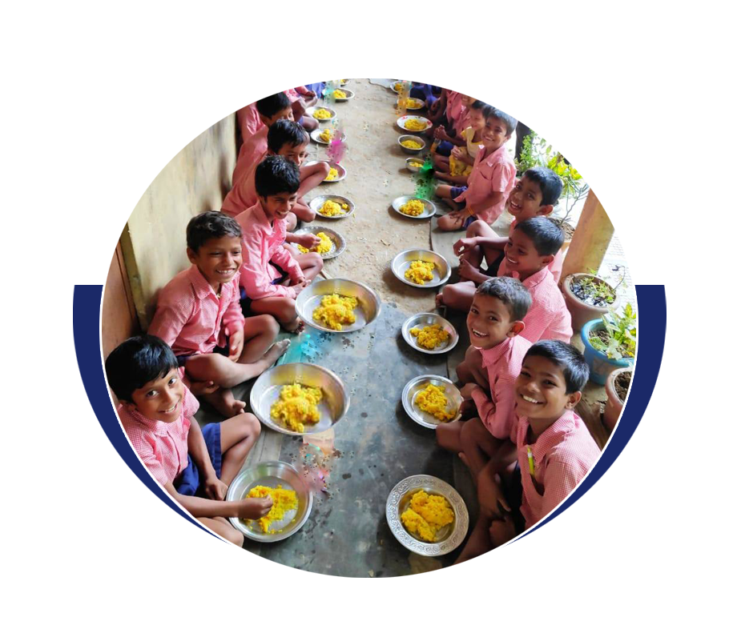
A brief presentation on Mid-Day-Meal Scheme, Assam

Slide 2
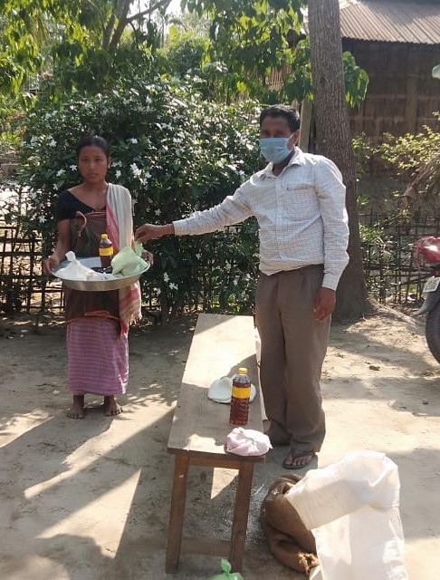
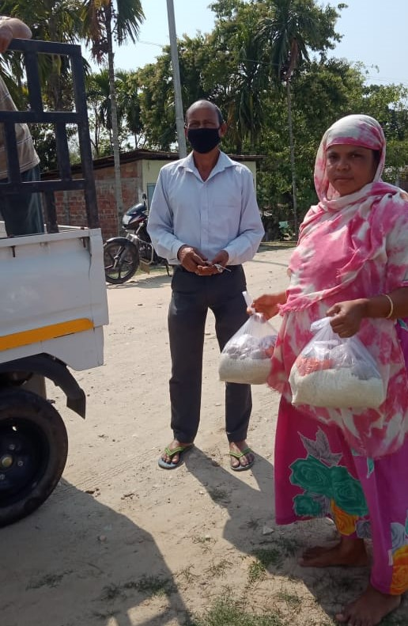
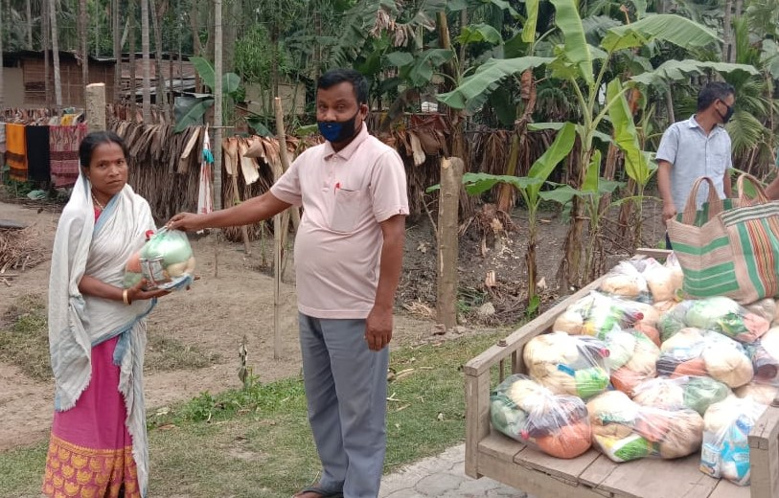
Distribution of Food Security Allowance during COVID-19
Food Security Allowance has been provided to the eligible children against all school working days during the closure period due to outbreak of COVID-19 virus.
Either HT/HM/Teacher if his/her house is situated in the same village/locality of the school or otherwise SMC/SMDC President distributed Food Security Allowance to the children as per entitlement by visiting their houses only observing all the norms as laid down by the Health Department..

Slide 3
Best Practices
MDMS, Assam
School Nutrition Garden
Multi tap Hand Washing Facility
Sampriti Bhojan
Guideline on Food Safety and Hygiene for Kitchen
Pictorial posters related to MDM Scheme

Slide 4
MDMS, Assam
MDMS, Assam
SCHOOL NUTRITION GARDEN
School Nutrition Garden is a source of fresh nutritious vegetables (leafy & green vegetable) for school feeding.
Most of the Kitchen Gardens set up in 2018-19 were washed away in the devastating flood in Assam during July/19 and August/19. Considerable steps were taken to set up School Nutrition Garden in each & every school covered under Mid-Day Meal Scheme again.
District level committee of School Nutrition Garden under the chairmanship of the Deputy Commissioner and members from the line departments have been constituted in all the districts.
At present, out of 53427 schools, 22154 schools in the State of Assam are having Nutrition Gardens and setting up of Kitchen Gardens is in progress in 11550 schools.

Slide 5
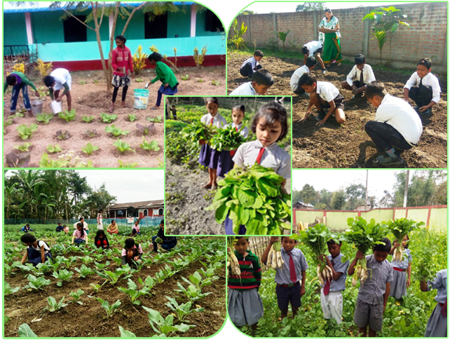
MDMS, Assam

Slide 6
MDMS, Assam
MDMS, Assam
Multi Tap Hand Washing Facility
Assam model of Group Hand-washing before and after Mid-Day-Meal is one of the best model in the country with low cost high value principle.
Total 422 schools of Rani, Rampur and Kamalpur blocks of Kamrup Rural district provided low cost Group Hand-washing facility with UNICEF support.
It has reduced the diseases like diarrhoea, skin disease etc.
Growing good habits from the early childhood stage.

Slide 7
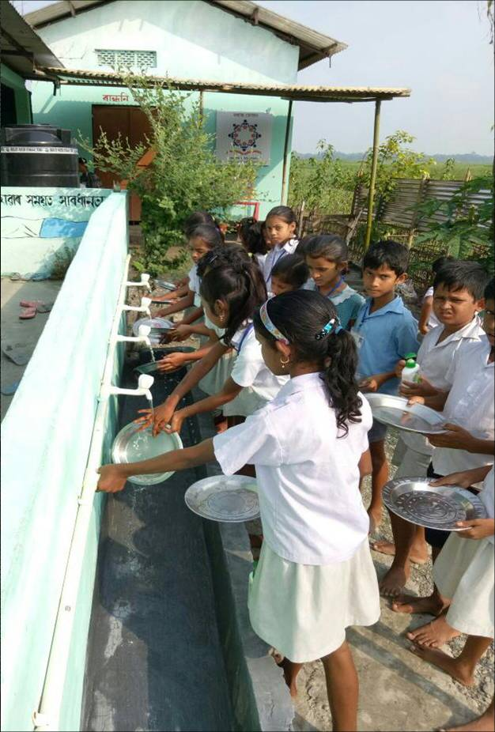
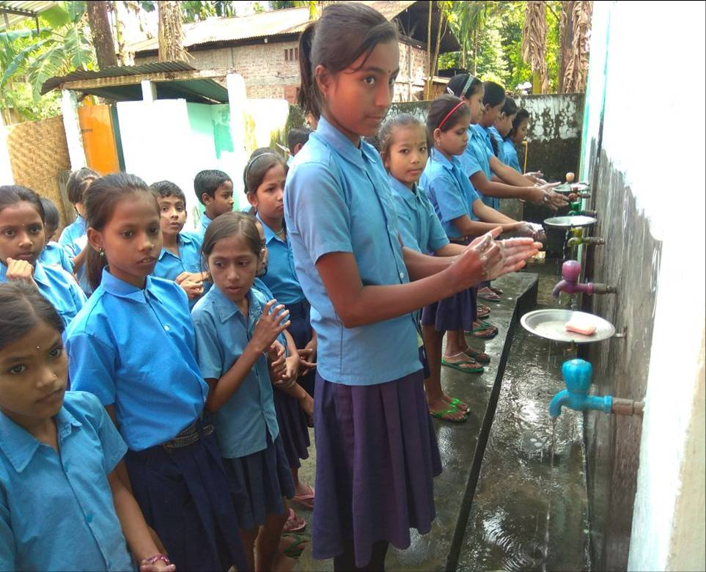
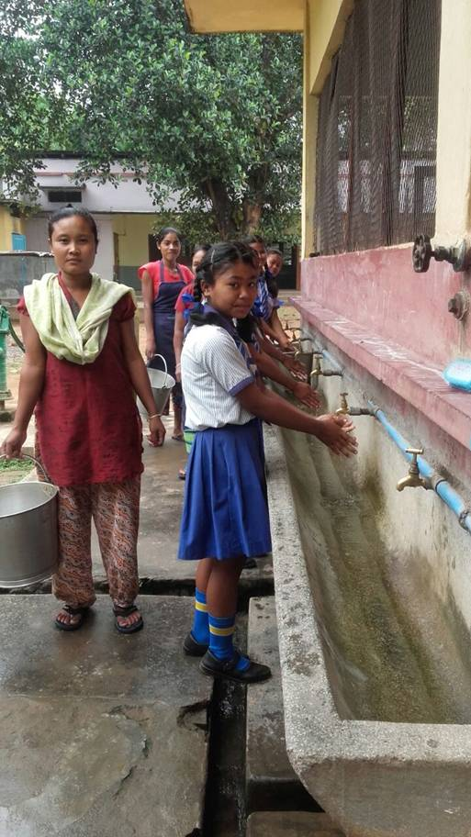
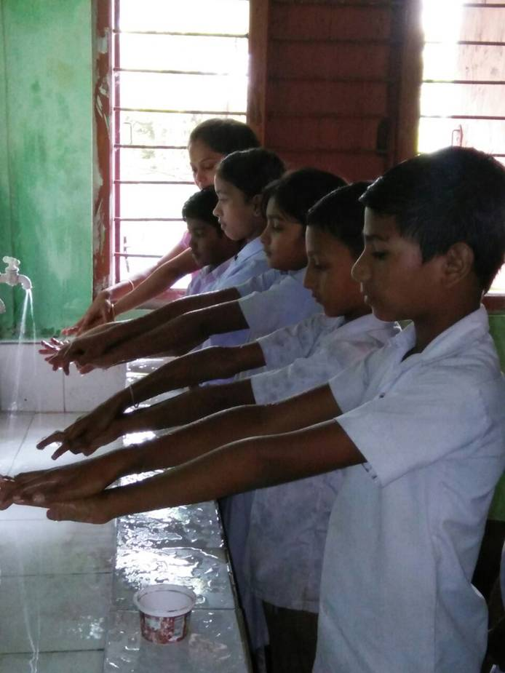
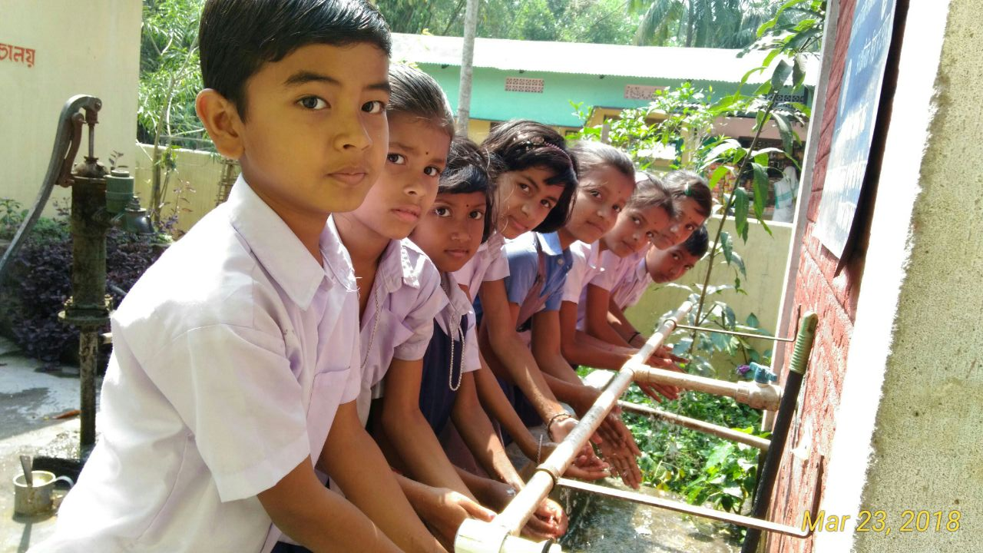
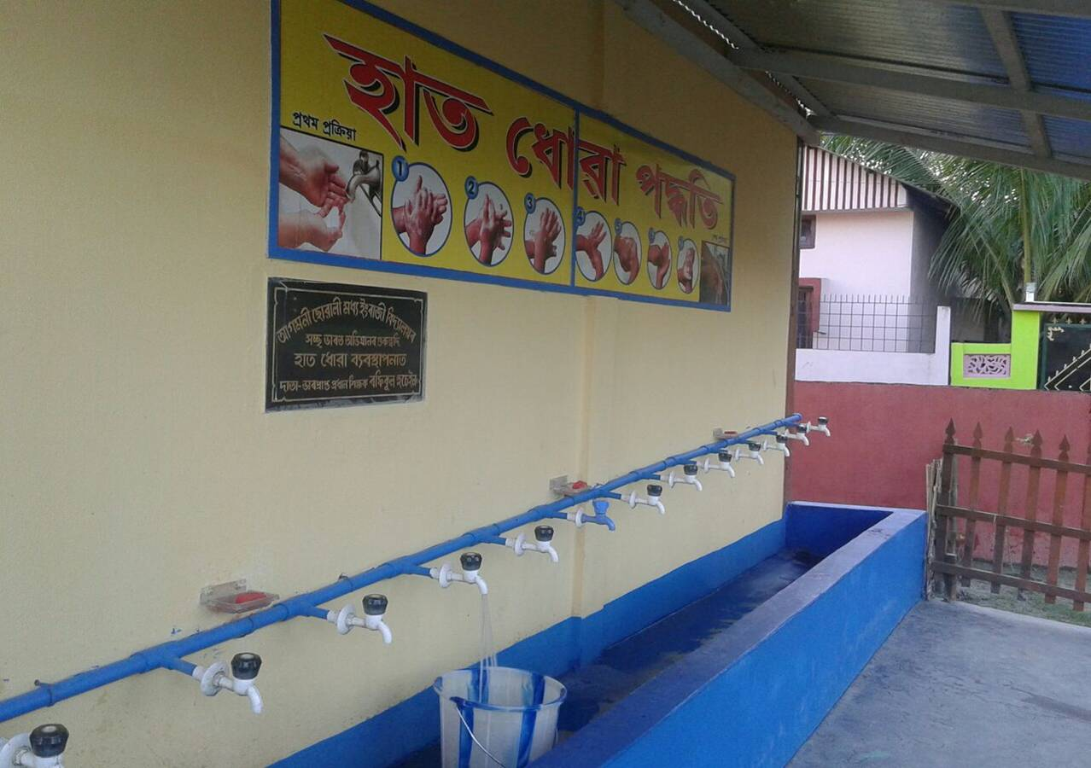
MDMS, Assam

Slide 8
MDMS, Assam
Pictorial wall posters related to MDM Scheme as Information Education Communication (IEC) Material
Pages | Contents
1 | Norms of Mid-Day Meal Scheme, Weekly Suggested Menu and ARMS
2 | School Nutrition Garden
3 | Sampriti Bhojan (Tithi Bhojan)
4 | Pictorial poster on Food Safety & Hygiene aspect of implementation of MDMS at schools
5 | Pictorial poster on Health & Hygiene aspect to be followed in schools as per contents provided by NHM
6 | Pictorial posters related to Disaster Mgmt Information provided by Assam State Disaster Management Authority

Slide 9
Providing IEC materials to every school under MDMS

Slide 10
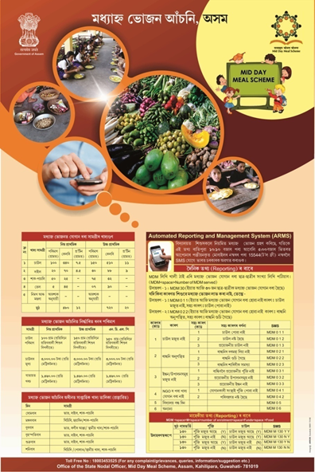
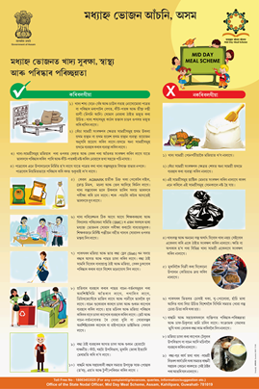
Providing IEC materials to every school under MDMS

Slide 11
MDMS, Assam
Sampriti Bhojan
State is implementing ‘Sampriti Bhojan Programme’ to encourage communities in the schools to benefit the children.
Members of community provides additional food items on special occasions i.e. Birthdays, Anniversaries, Festivals, Days of National importance etc.
During the programme, supplementary nutritive items like sweet, bread butter/ jam, egg, apple, banana, orange, chick pea, moong, milk, snacks, biscuits etc. are provided to the children of the schools in addition to Mid-Day Meal.
Hoarding on Sampriti Bhojan were installed in prominent places of the districts to upscale the programme.

Slide 12
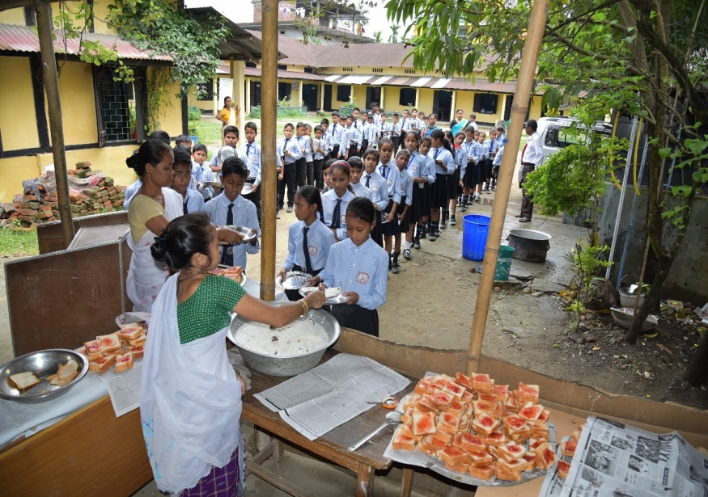
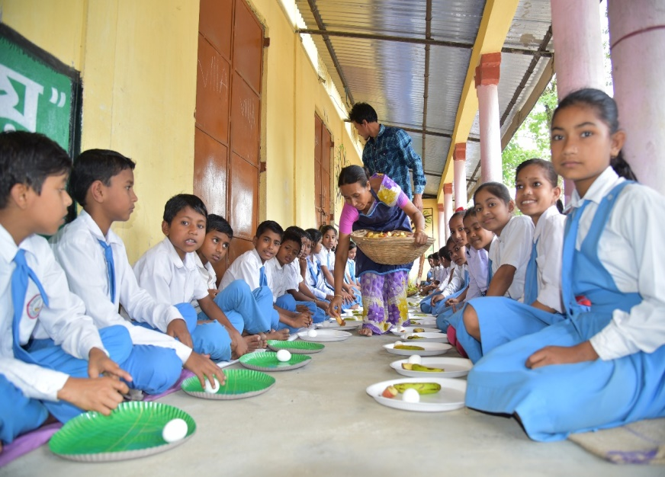
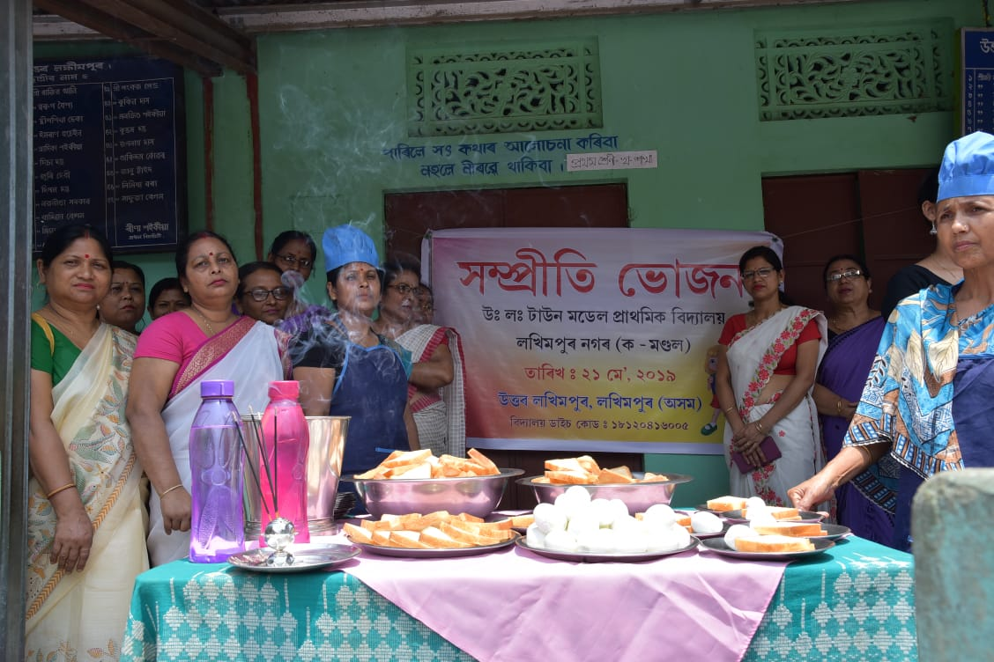
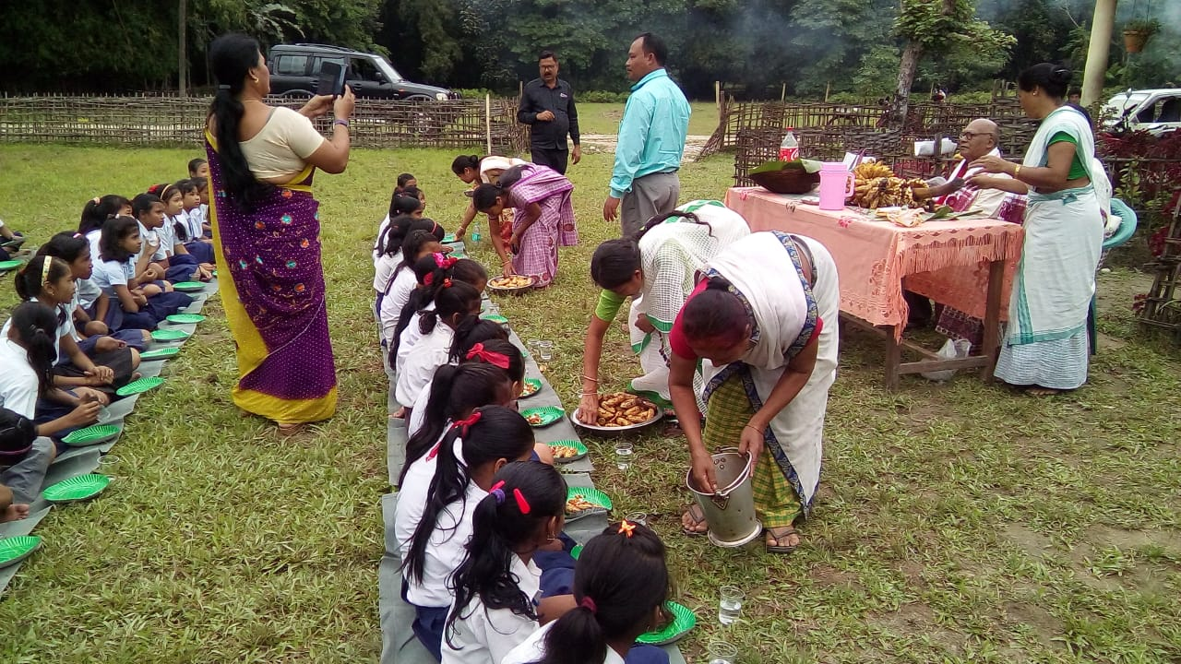
MDMS, Assam
Additional food items like Egg, Banana, Bread Butter/Jam, Chick pea, Sweets etc. distributed in Sampriti Bhojan

Slide 13
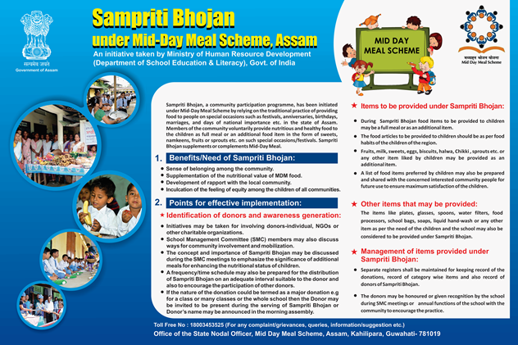
MDMS, Assam
2 nos. of Hoardings installed in prominent places of each district of Assam for Guidelines on Sampriti Bhojan

Slide 14
MDMS, Assam
Guideline on Food Safety and Hygiene for Kitchen
Guidelines on food safety and hygiene for school level kitchens under MDM Scheme have been translated into Assamese, Bengali and Bodo languages and distributed to all schools.
MDM Rules, 2015 have also been translated into Assamese, Bengali and Bodo languages and printed in the said booklet.
Training has been imparted to Cook cum Helpers, President & Member Secretary of the SMCs on food safety and hygiene for school level kitchens and MDM Rules, 2015.
‘MDM Rules, 2015’ and ‘Guideline of Sampriti Bhojan’ have been incorporated in the training module of SMC’s members under Samagra Shiksha.

Slide 15
MDMS, Assam
Assamese
Bengali

Slide 16
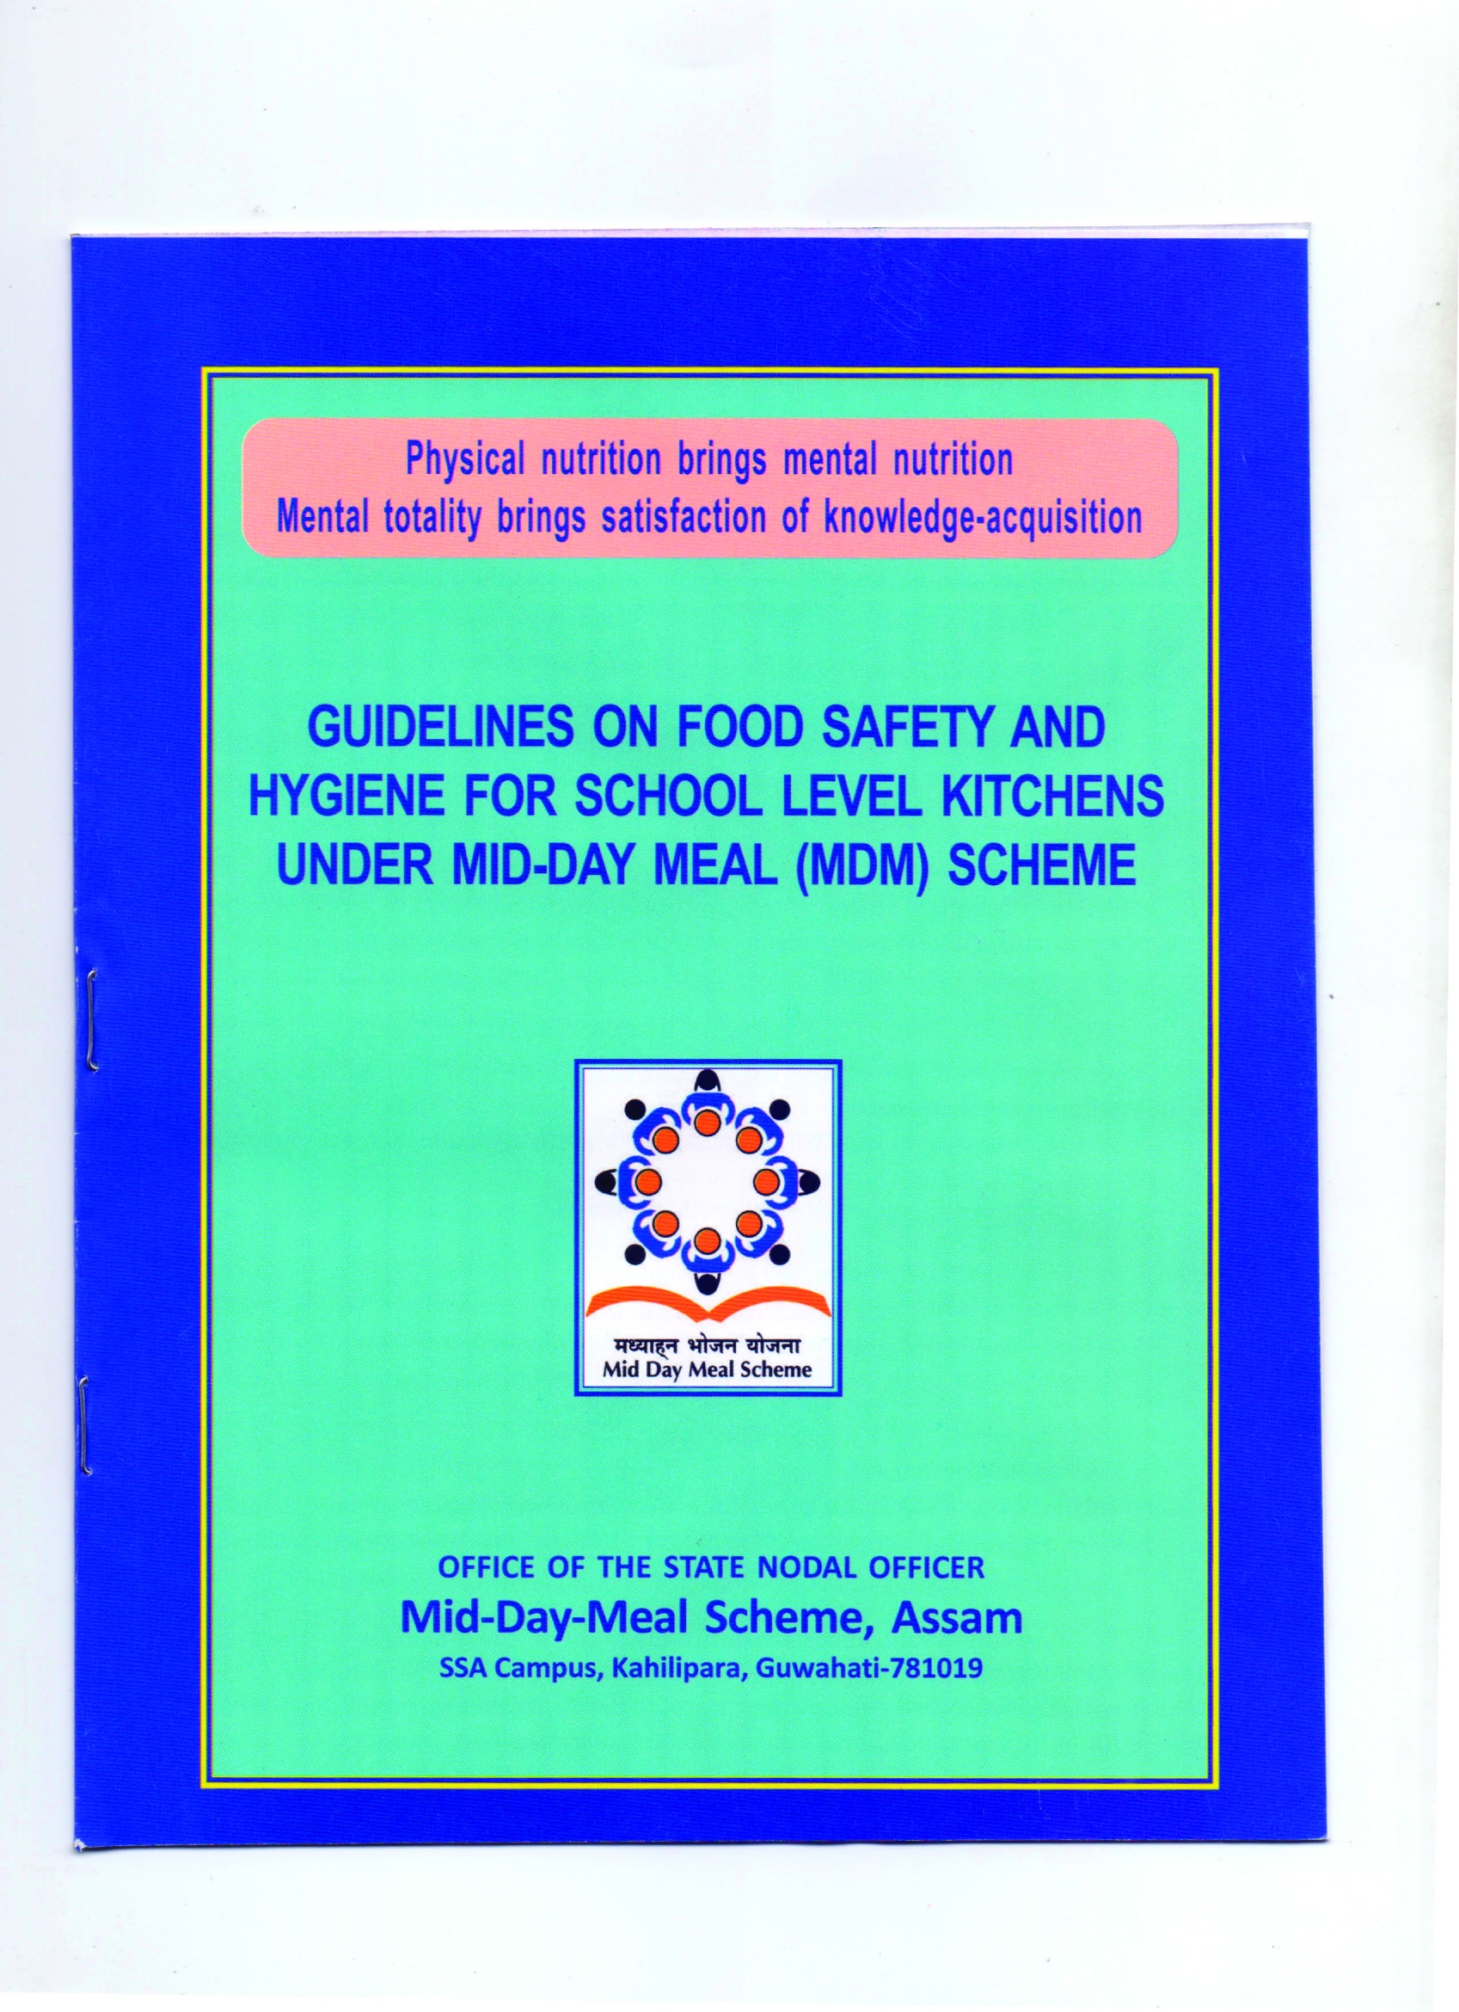
MDMS, Assam
Bodo
English

Slide 17
MDMS, Assam
Proposals during the financial year 2020-21:

Slide 18
Proposal for Annual Work Plan & Budget (AWP&B), 2020-21
A. No. of institution to be opted Mid-Day Meal as per U-DISE, 2018-19 for the FY 2020-21:
Category | Primary (I-V) | Upper Primary (VI-VIII) | Primary with Upper Primary (I-VIII) | NCLP | Total
Institution | 40,184 | 10,252 | 3,443 | 134 | 54,013
B. No. of Children, Cook cum Helper & Working days to be opted MDMS for the FY 2020-21:
Category | Primary (I-V) | Upper Primary (VI-VIII) | NCLP | Total
Children | 27,16,040 | 13,31,872 | 4,394 | 40,52,306
Cook-cum-Helpers | 85,499 | 33,499 | - | 1,18,998
Working Days | 235 | 235 | 312 | -
C. Proposal for Food grains Allocation in AWP &B, 2020-21
# | Stage | Proposal for food grains |  | Quantity in MTs.
 |  | No. of children | No. of working days
1 | Primary @ 100 gms / child / school day (27,16,040x 235 x 0.0001) | 27,16,040 | 235 | 63826.947
2 | Upper Primary @ 150 gms / child / school day (13,31,872x 235 x 0.00015) | 13,31,872 | 235 | 46948.493
3 | NCLP @ 150 gms / child / school day (4,394x 312 x 0.00015) | 4,394 | 312 | 205.639
Total |  | 40,52,306 | - | 110981.079

Slide 19
MDMS, Assam
Proposal for FY 2020-21
(Rs. in lakh)
# | COMPONENT | Central Share | State Share | Total
Recurring
1 | COOKING COST | 49592.81 | 5549.05 | 55141.86
2 | HONORARIUM | 10709.82 | 1189.98 | 11899.80
3 | COST OF FOODGRAINS | 3329.43 | 0.00 | 3329.43
4 | TRANSPORTATION COST | 1509.35 | 0.00 | 1509.35
5 | MME | 1758.82 | 0.00 | 1758.82
Total |  | 66900.23 | 6739.03 | 73639.26
6 | Summer Vacation (Cooking cost, Cost of Food grains &Transportation Assistance) | 6714.66 | 684.54 | 7399.20
Total Recurring |  | 73614.89 | 7423.57 | 81038.46
Flexi fund | 2856.97 | 317.44 | 3174.41

Slide 20
Flexi Fund for 2020-21
1. Development of School Nutrition Garden
State has proposed to develop School Nutrition Garden in 19,723 schools @Rs.5,000/- per school. Total estimated outlay of 986.16 lakh @5,000/- per school, which comprises of 887.54 lakh as Central Share and 98.62 lakh as State Share.
2. Providing Nutritious Items
State has proposed to provide nutritious item like banana to all 40,52,306 children in 27 days in a year. For providing banana to the children as proposed a local farmer will be contacted to supply the banana and the expertise of the farmer is planned to utilize for developing School Nutrition Garden.
Total estimated outlay of 2188.25 lakh @Rs.2/- per child per day for 27 days (Rs.54/- per child per year), which comprises of Rs.1969.43 lakh as Central Share and Rs.218.82 lakh as State Share.

Slide 21
Thank you

